Slide 1
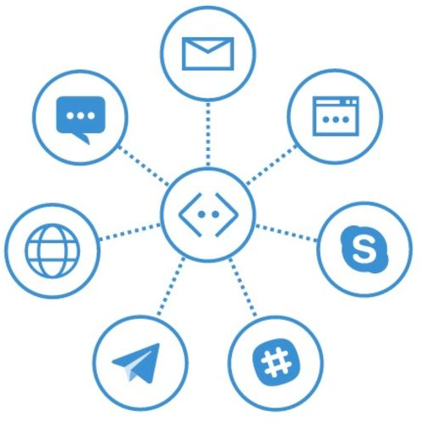

Testing Bots
Mithun Prasad, PhD miprasad@Microsoft.com

Slide 2

Testing Bots
What Should We Test?
How do you test a bot?
Mocking
Unit/Functional/Load Testing
- Channel Testing

Slide 3
Unit Tests
Mock out the Bot Framework
Perform Unit Testing by reusing the Bot Builder code
DialogTestBase.cs
FiberTestBase.cs
MockConnectorFactory.cs
Runs locally

Slide 4
What is Mocking?
Simulate the behaviour of real objects
Used in unit testing
Used when the unit being tested has external dependencies
To isolate the behaviour of object you want to test, the other objects will be replaced by mocks that simulate the behaviour of the real objects
Useful if the real objects are impractical to incorporate into the unit test
Moq for Bots - mocking framework for .NET

Slide 5
Testing Channels
Host the Bot service on a public URL endpoint
When designing / building / testing your code, you don’t always want to have to redeploy
Redeploying means paying hosting costs

Slide 6
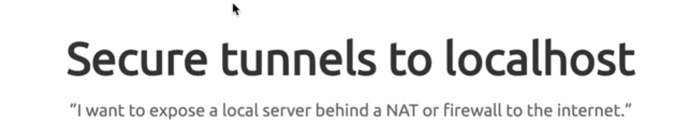
Ngrok

Slide 7

What is Ngrok?
Adam ngrok
John
Tunnel

Slide 8
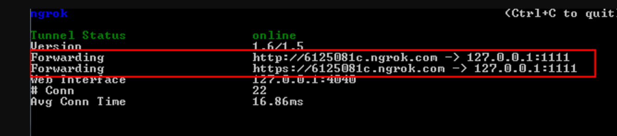
Forwarding
ngrok http 1111

Slide 9
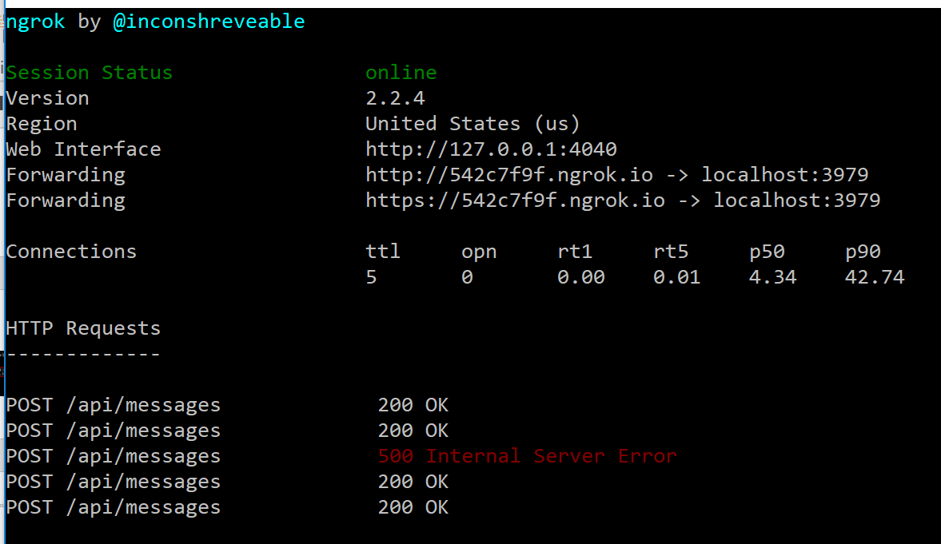
Forwarding
Given the bot is being hosted on localhost:3979, use ngrok to expose it to public internet
ngrok.exe http 3979 -host-header="localhost:3979"
The forwarding url is the
public endpoint for the
bot service

Slide 10
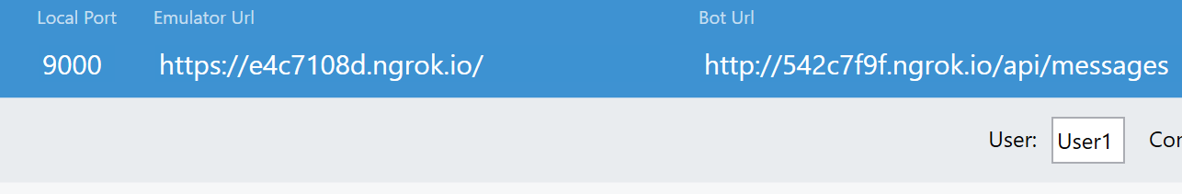
Testing Emulator on Public Endpoints
The forwarding public urls from ngrok can be used in the emulator as shown below

